Slide 1

Domestic Violence and Social Services in Kansas City
Nick Fry
November 2020

Slide 2
Domestic violence is occurring more often as people change patterns of life during Covid-19.

Slide 3
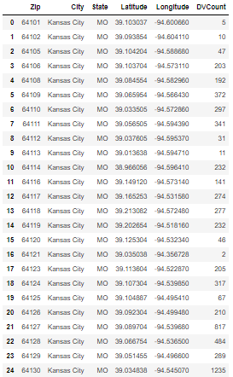
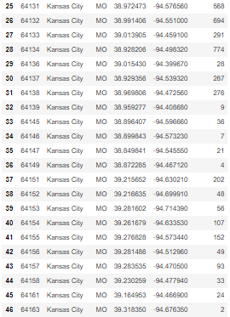
Rates of domestic violence by zip code in Kansas City; 2020 alone

Slide 4
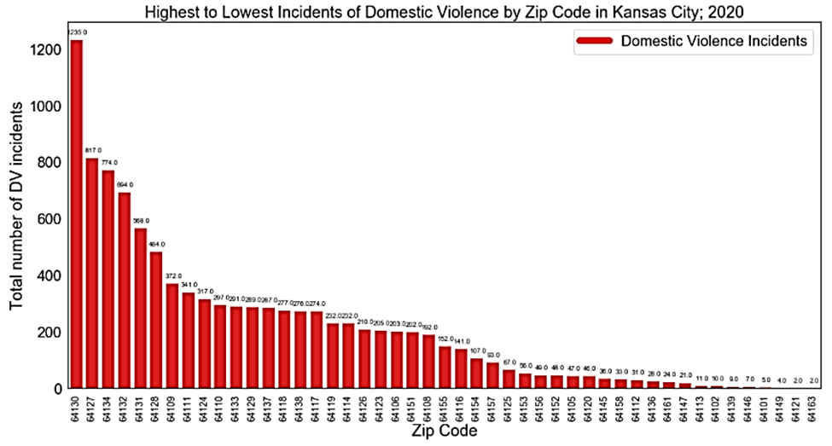
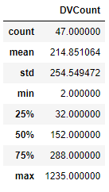
Rates of domestic violence by zip code in Kansas City; 2020 alone

Slide 5
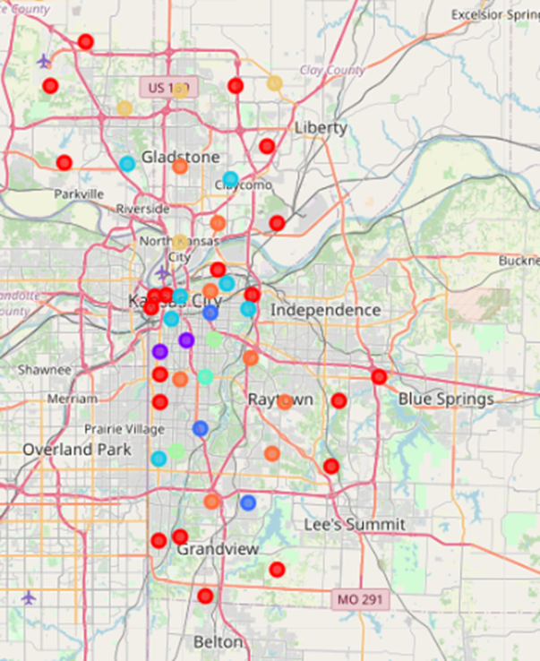
Clusters of domestic violence across a map

Slide 6
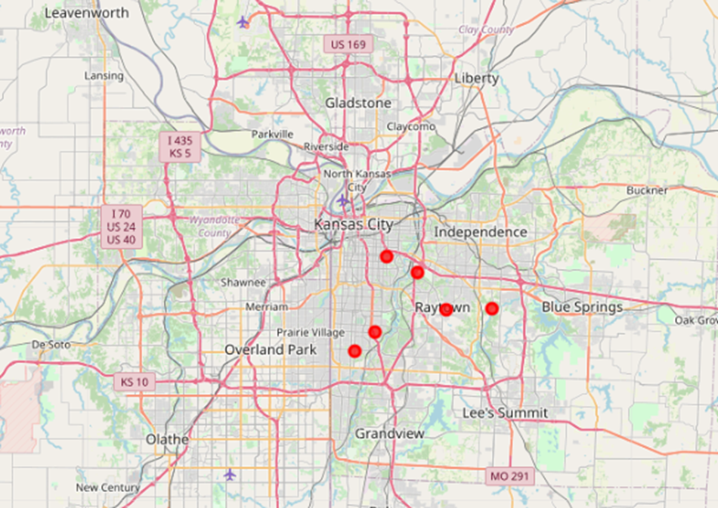
Isolating the areas with the highest rates of domestic violence

Slide 7
Do these high-risk domestic violence areas correspond with women’s shelters?

Slide 8
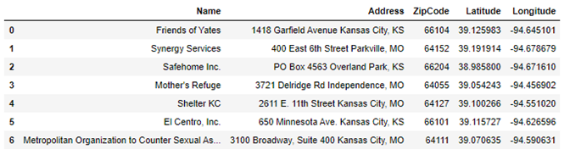
A list of women’s shelters in Kansas City

Slide 9
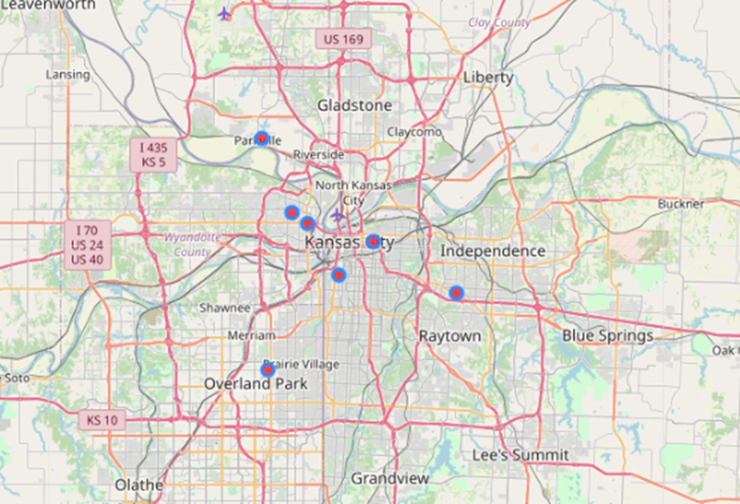
Women’s shelters on a map

Slide 10

Women’s shelters vs. domestic violence
Women’s shelters
High-rates of domestic violence

Slide 11
Do these high-risk domestic violence areas correspond with women’s shelters?
No.
Only Mothers Refuge and Safehome Inc. are near the most affected areas. Most of the Kansas City social services to prevent domestic violence exist in low-incident neighborhoods.

